Slide 1

Model Building and Predictions
Team Invincible Predictors
*Apoorv Panse
*Deepti Chawda
*Shahbaz KHan
Recruit restaurant visitor forecasting project

Slide 2
Updated Data Merging after EDA
We found out that HPG tables were not required to be merged at all as our training set contains actual visitors data and we do not have reservation data available for most of it.
So we only merged air_store_info and date_info tables with train dataset to get final training dataset and added extra features as required.
Overall we played around with only 3 CSV files for model training : train.csv, air_store_info.csv, date_info.csv and merged these to form our train_data dataframe.

Slide 3
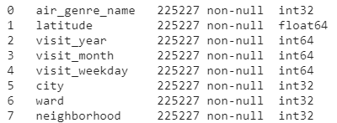
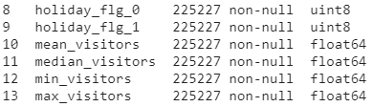
Final Set of features for Model Training
*Label encoding was used for categorical features having more than two categories
*One hot encoding was used for categorical features having binary categories.
*mean, median, min, max visitor features were added for better prediction possibility.

Slide 4
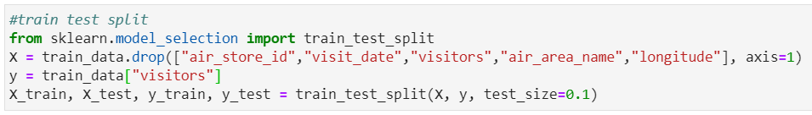
Training Testing Splits
*Train and test data was split in 80% and 20% respectively.
*air_store_id, visit_date, air_area_name, and longitude columns were dropped for training as they are not taken as features as they were not improving the score.
*Random split was done because we saw that there is not much difference in the average visitors year wise.
*Note that we have split train.csv into two parts here and test data is not from sample submission file.

Slide 5
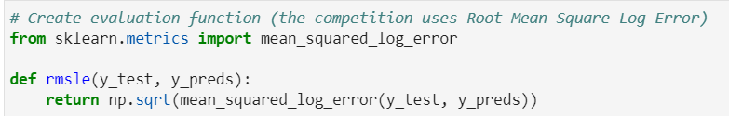
Model Selection and evaluation metric
As predicting the number of visitors is the regression problem, we have tried few regression models : * Simple Linear Regression
* KNeighbors Regression
* Random Forest Regression
Evaluation Metric used was RMSLE (Root mean squared logarithmic error)

Slide 6
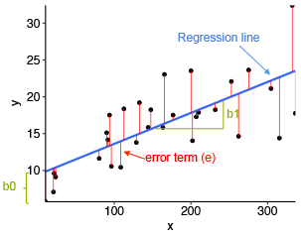
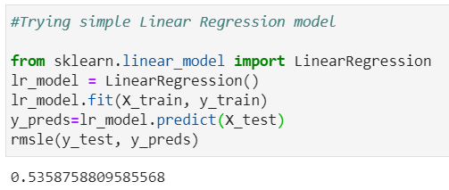
Model 1 : Linear Regression
*We used scikit-learn library for implementing
Linear regression model.
*It uses Ordinary least squares Linear Regression.
*Linear Regression fits a linear model with coefficients to minimize the residual sum of squares between the observed targets in the dataset, and the targets predicted by the linear approximation.

Slide 7
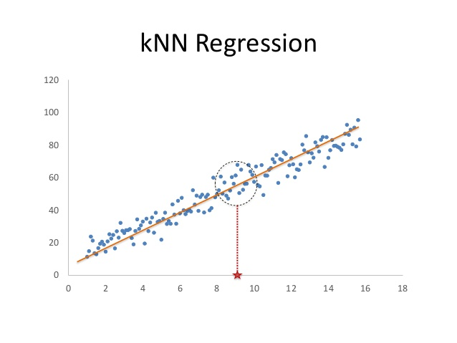
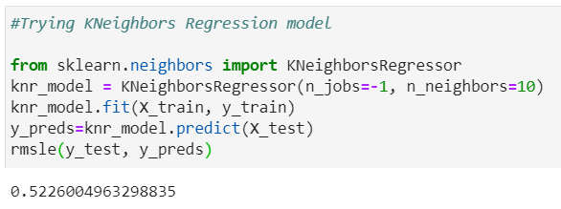
Model 2 : KNeighbors Regression
*Regression based on k-nearest neighbors.
*The target is predicted by local interpolation of the targets associated of the nearest neighbors in the training set.

Slide 8
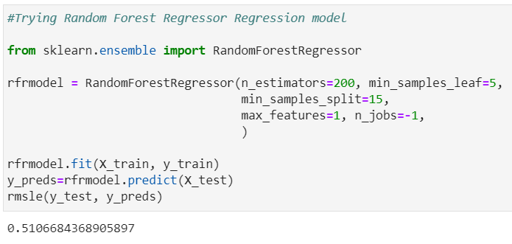
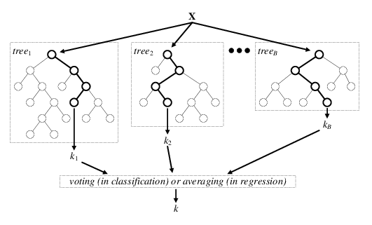
Model 3 : Random Forest Regression
* A random forest is a meta estimator that fits a number of classifying decision trees on various sub-samples of the dataset and uses averaging to improve the predictive accuracy and control over-fitting.

Slide 9
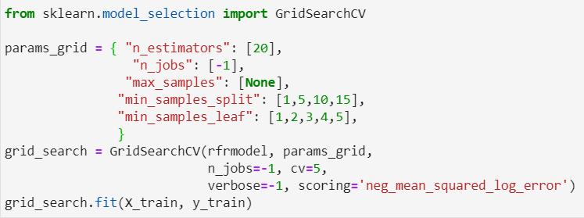
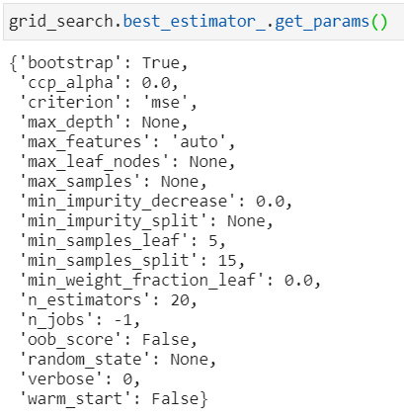
GridSearchCV : Hyperparameter Tuning
* We tried to tune the hyperparameters for random forest search and the result improved with the score as shown in previous slide.

Slide 10
Predictions
For actual predictions of sample submission data, it was featured exactly how we did for training dataset. Now entire train dataset is our training data and featured Sample submission became the test dataset for Kaggle submission.
Random Forest Regression gave the best result of RMSLE score of 0.51066 on training set and 0.53868 on Kaggle
Average result of all models was RMSLE score 0.54234 and taking average did not improve the score.

Slide 11
What else we could have done?
We could have used the time series forecasting models like ARIMA for better prediction.
We could have used the Gradient boosting algorithms such as XGBoost and Light GBM.
However the reason we did not pick up those, is because we wanted to learn more about how regression techniques work and not focus on the Kaggle score.

Slide 12
